Slide 1

A Comparative Study of Ridge , Lasso and PC Regression
APP DEFENSE
Franck A. Olilo
Under the supervision
of
Dr. Iresha Premarathna

Slide 2
A Comparative Study of Ridge , Lasso and Principal Components regression
Multicollinearity
Ridge
LASSO
PCR
HANDLE MULTICOLLINEARITY
30 MIN

Slide 3


LINEAR REGRESSION
Multiple linear regression can be express as :
$y=β_{0}+β_{1}x_{1}+β_{1}x_{1}+…+β_{k}x_{k}+ε$
$β_{0}$ , $β_{1}$, …, $β_{k}$ are regression coefficients and $ε$ is error
Assumptions of Linear Regression
- Linear relationship
- No Autocorrelation
- No to little multicollinearity
- Etc…

Slide 4
MULTICOLLINEARITY: Sources
The sources of multicollinearity can be limited to:
-Data Collection
-Variable Selection
-Model formulation

Slide 5
MULTICOLLINEARITY: Consequences
-Variance Inflation
-Unreliable Significance
-Estimation Instability

Slide 6

MULTICOLLINEARITY: Consequences
-Variance Inflation
$$y=β_{1}x_{1}+β_{2}x_{2}+ε$$
$$\left[\begin{matrix}1 & r_{12} \\ r_{12} & 1\end{matrix}\right]\left[\begin{matrix}{\hat{β}}_{1} \\ {\hat{β}}_{2}\end{matrix}\right]=\left[\begin{matrix}r_{1y} \\ r_{2y}\end{matrix}\right]$$
${\hat{β}}_{1}=$ $\frac{r_{1y}−r_{12}r_{2y}}{{(1+r_{12})}^{2}}$
$$V\left(\hat{β}\right)=σ^{2}{(X^{′}X)}^{−1}=\frac{σ^{2}}{1−r^{2}}$$

Slide 7
MULTICOLLINEARITY: Identifications
Correlation Matrix
Eigen value and Condition Number
Variance Inflation Factor / Tolerance
Using Pearson correlation
Any value greater than 0.8
Eigen value close to 0
CN greater than 30
VIF greater 5 or 10
Tolerance below 0.1

Slide 8
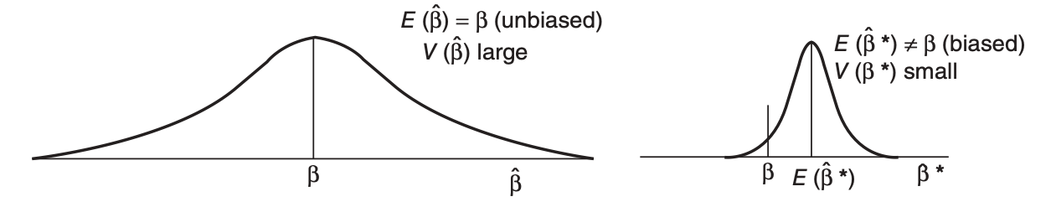
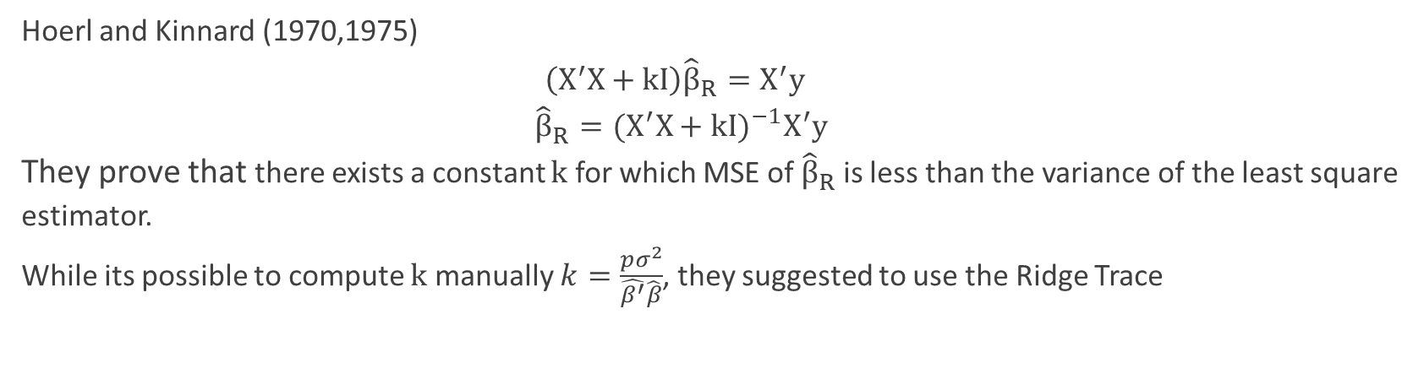
RIDGE REGRESSION
Hoerl and Kinnard (1970,1975)
$\left(X^{′}X+kI\right){\hat{β}}_{R}=X^{′}y$
${\hat{β}}_{R}={(X^{′}X+kI)}^{−1}X^{′}y$
They prove that there exists a constant $k$ for which MSE of ${\hat{β}}_{R}$ is less than the variance of the least square estimator.
While its possible to compute $k$ manually $k=\frac{pσ^{2}}{\hat{β^{′}}\hat{β}}$, they suggested to use the Ridge Trace

Slide 9
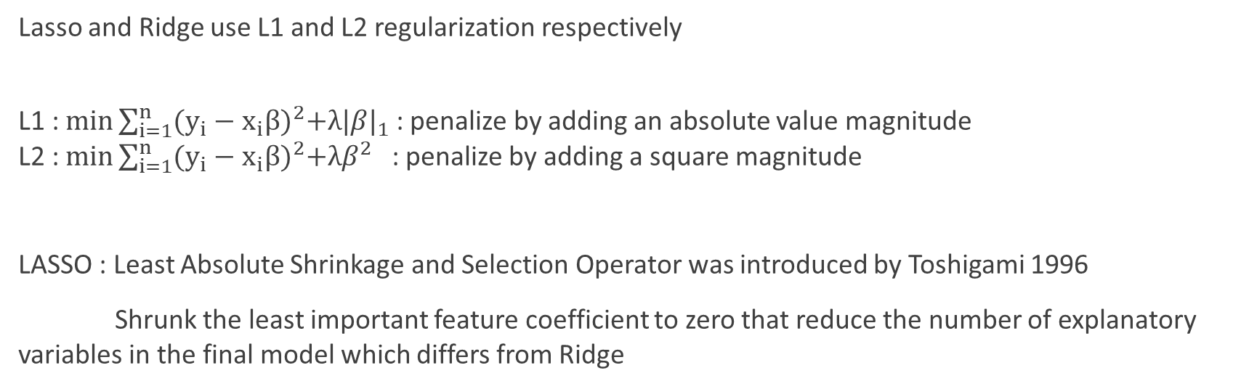
LASSO REGRESSION
Lasso and Ridge use L1 and L2 regularization respectively
L1 : $\min{\sum_{i=1}^{n}{{(y_{i}−x_{i}β)}^{2}+λ{|β|}_{1}}}$ : penalize by adding an absolute value magnitude
L2 : $\min{\sum_{i=1}^{n}{{(y_{i}−x_{i}β)}^{2}+λβ^{2}}}$ : penalize by adding a square magnitude
LASSO : Least Absolute Shrinkage and Selection Operator was introduced by Toshigami 1996
Shrunk the least important feature coefficient to zero that reduce the number of explanatory variables in the final model which differs from Ridge

Slide 10
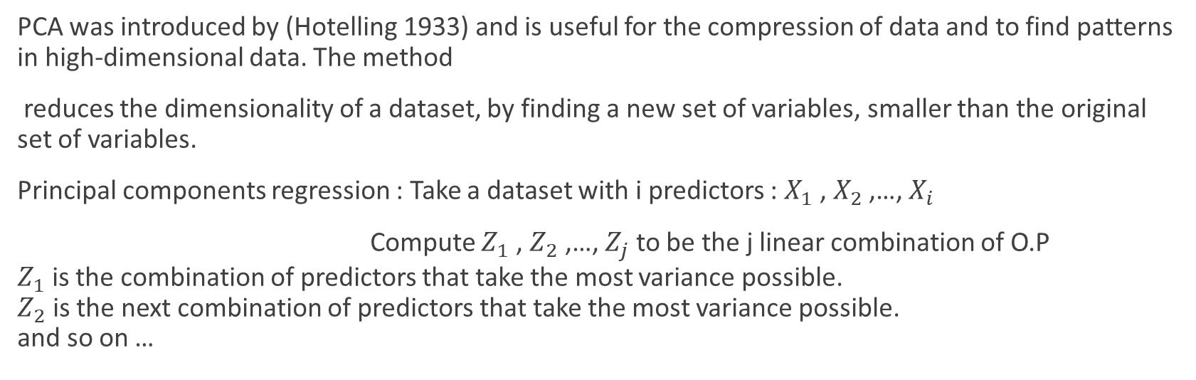
PRINCIPAL COMPONENTS REGRESSION
PCA was introduced by (Hotelling 1933) and is useful for the compression of data and to find patterns in high-dimensional data. The method
reduces the dimensionality of a dataset, by finding a new set of variables, smaller than the original set of variables.
Principal components regression : Take a dataset with i predictors : $X_{1}$ , $X_{2}$ ,…, $X_{i}$
Compute $Z_{1}$ , $Z_{2}$ ,…, $Z_{j}$ to be the j linear combination of O.P
$Z_{1}$ is the combination of predictors that take the most variance possible.
$Z_{2}$ is the next combination of predictors that take the most variance possible.
and so on …

Slide 11
Advantages and Disadvantage
 | Advantage | Disadvantage
Ridge Regression | - Does not required unbiased estimators -Improve least square estimate in case of multicollinearity -Avoids Overfitting | Include all predictors No feature selection Trade variance for bias
Lasso Regression | Feature selection Reduce overfitting Easy interpretation | Biased Coefficient Prediction performance less than ridge
PC Regression | Delete most correlated features Avoids overfitting | Sometimes need large data Data information may get loss

Slide 12
CASE STUDY : Data
The data used in this paper was obtained from Kaggle
251 Observations
7 Variables
Body Fat | Weight | Chest | Abdomen | Hip | Thigh | Biceps
12.3 | 154.25 | 93.1 | 85.2 | 94.5 | 59 | 32
6.1 | 173.25 | 93.6 | 83 | 98.7 | 58.7 | 30.5
25.3 | 154 | 95.8 | 87.9 | 99.2 | 59.6 | 28.8
… | … | … | … | … | … | …
29.3 | 186.75 | 111.1 | 111.5 | 101.7 | 60.3 | 31.3
26 | 190.75 | 108.3 | 101.3 | 97.8 | 56 | 30.5
31.9 | 207.5 | 112.4 | 108.5 | 107.1 | 59.3 | 33.7

Slide 13
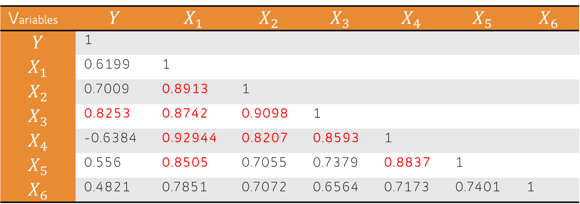
CASE STUDY : Identify multicollinearity
Pearson Correlation
Variables | $$Y$$ | $$X_{1}$$ | $$X_{2}$$ | $$X_{3}$$ | $$X_{4}$$ | $$X_{5}$$ | $$X_{6}$$
$$Y$$ | 1
$$X_{1}$$ | 0.6199 | 1
$$X_{2}$$ | 0.7009 | 0.8913 | 1
$$X_{3}$$ | 0.8253 | 0.8742 | 0.9098 | 1
$$X_{4}$$ | -0.6384 | 0.92944 | 0.8207 | 0.8593 | 1
$$X_{5}$$ | 0.556 | 0.8505 | 0.7055 | 0.7379 | 0.8837 | 1
$$X_{6}$$ | 0.4821 | 0.7851 | 0.7072 | 0.6564 | 0.7173 | 0.7401 | 1

Slide 14


CASE STUDY : Identify multicollinearity
Eigen values and Condition Number
Eigen value | 5.57160 | 0.65073 | 0.316316 | 0.27289 | 0.08840 | 0.053869 | 0.046181
$$Condition Number=\frac{MAX λ_{i}}{MIN λ_{i} }$$
$$Condition Number=\frac{5.57160}{0.046181}$$
$$Condition Number=120.64$$

Slide 15
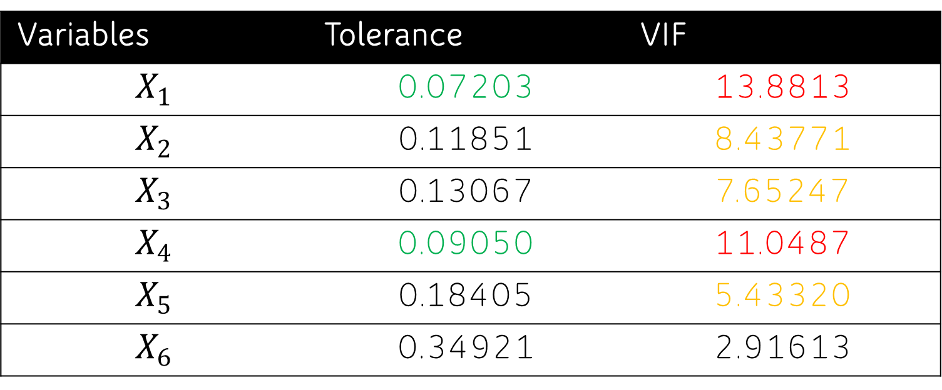
CASE STUDY : Identify multicollinearity
Variables | Tolerance | VIF
$$X_{1}$$ | 0.07203 | 13.8813
$$X_{2}$$ | 0.11851 | 8.43771
$$X_{3}$$ | 0.13067 | 7.65247
$$X_{4}$$ | 0.09050 | 11.0487
$$X_{5}$$ | 0.18405 | 5.43320
$$X_{6}$$ | 0.34921 | 2.91613
Variance Inflation Factor / Tolerance

Slide 16
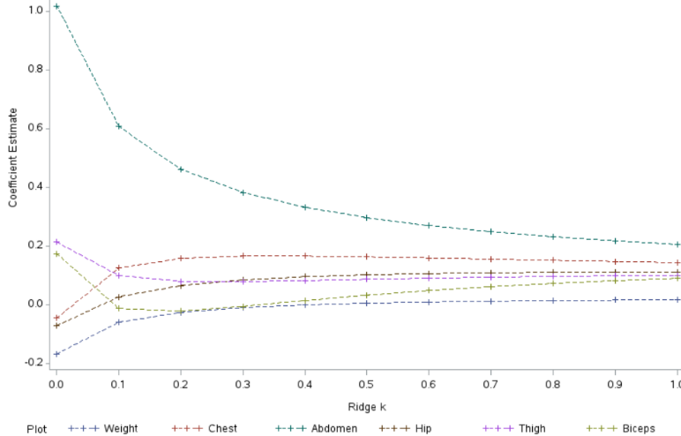
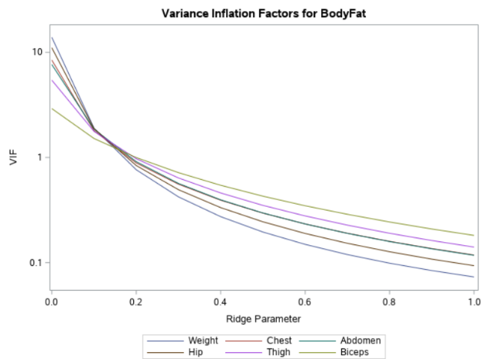
CASE STUDY : Ridge Regression
Ridge trace / VIF trace

Slide 17
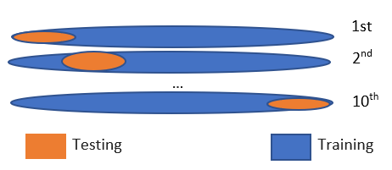
CASE STUDY : K-Fold Cross validation
Randomly splits the data into n approximately equal group
Split into two group, 9/10 go for training 1/10 for validation
Repeat the process n times
For ridge and Lasso , it look for the value of k that minimize the MSE
and give the optimal value after nth process
For PCR , the validation method look for the number of factor that
minimize the PRESS( predicted residual of sum of squares

Slide 18
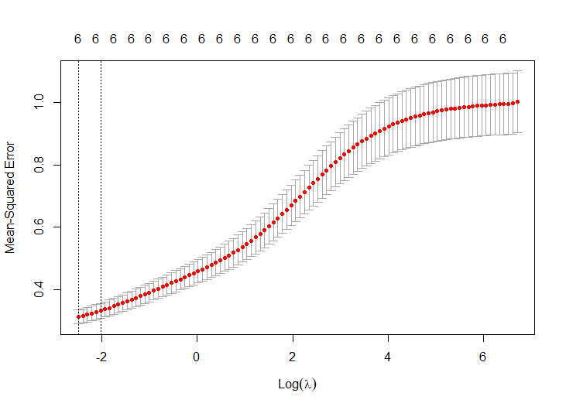
CASE STUDY : Ridge Regression
ridge2<-cv.glmnet(x,y,alpha=0) ridge3$lambda.min [1] 0.08237252
lasso<-glmnet(x,y,alpha=0,lambda=0.08237252) coef(ridge3) 7 x 1 sparse Matrix of class "dgCMatrix" s0 (Intercept) -2.431808e-16 Weight -2.208937e-01 Chest 1.106214e-01 Abdomen 7.941868e-01 Hip 1.314701e-02 Thigh 6.421203e-02 Biceps -8.189247e-04

Slide 19
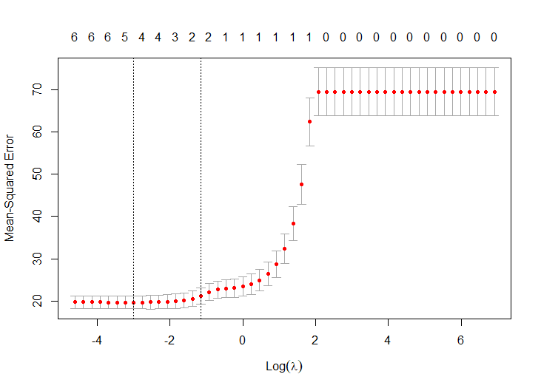
CASE STUDY : Lasso Regression
lasso$lambda.min [1] 0.005408755 lasso1<-glmnet(x,y,alpha=1,lambda=0.005408755) coef(lasso) 7 x 1 sparse Matrix of class "dgCMatrix" s0 (Intercept) -1.830331e-16 Weight -4.955335e-01 Chest . Abdomen 1.166109e+00 Hip . Thigh 8.420877e-02 Biceps 3.805854e-02

Slide 20
CASE STUDY : Principal Components Regression
 | PC1 | PC2 | PC3 | PC4 | PC5 | PC6
Standard Deviation | 2.244 | 0.651 | 0.558 | 0.311 | 0.29 | 0.214
Proportion of Variance | 0.839 | 0.07 | 0.052 | 0.0161 | 0.0143 | 0.007
Cumulative Proportion | 0.839 | 0.909 | 0.9618 | 0.977 | 0.992 | 1

Slide 21
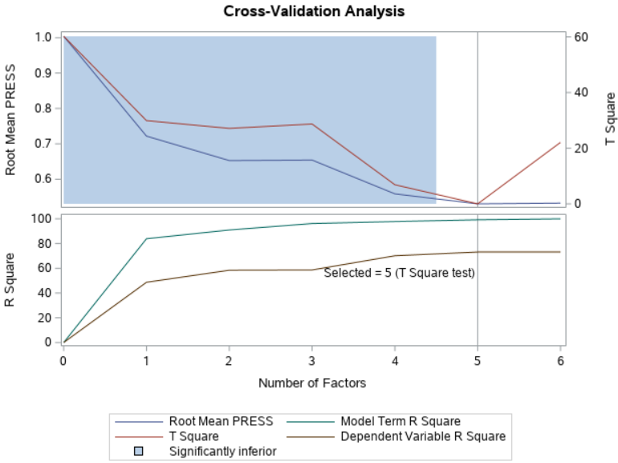
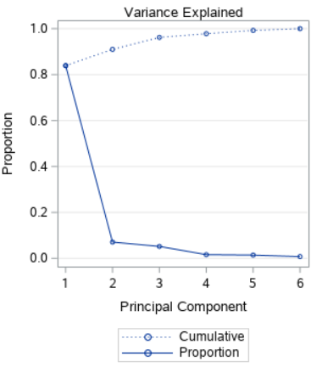
CASE STUDY : Principal Components Regression

Slide 22
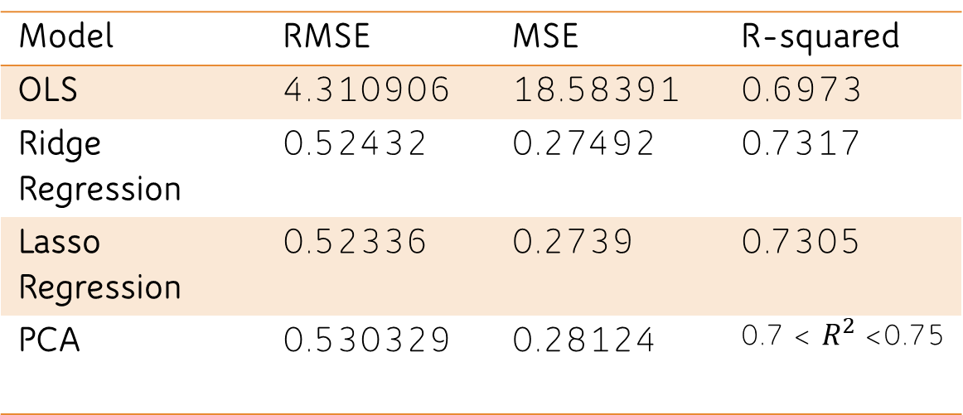
CASE STUDY : Model Comparison
Model | RMSE | MSE | R-squared
OLS | 4.310906 | 18.58391 | 0.6973
Ridge Regression | 0.52432 | 0.27492 | 0.7317
Lasso Regression | 0.52336 | 0.2739 | 0.7305
PCA | 0.530329 | 0.28124 | 0.7 < $R^{2}$<0.75

Slide 23
Conclusion

